Slide 1
SynthSeg Pre-processing And Applying an Evolutionary Algorithm for Feature Detection
Shreyas Mysore Narayana

Slide 2
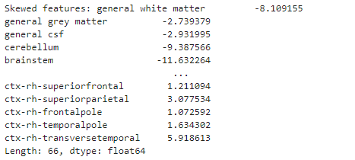
Feature Skewness
List features that are highly skewed
The above is the list of all the highly skewed features between the range of [1,-1]
The skeweness is handled by using the log transformation which in turn reduces the skewness of the data

Slide 3
Features with Low Variation
List features with low variation (state the threshold used)
The above lists the features with low variation when calculated for a threshold of 0.01

Slide 4
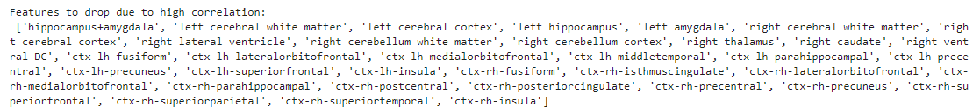
Features Correlated to the Target Variable
List features that correlate with the target variable
These are the list of features that highly correlate with the target variable with a threshold of 0.90 .

Slide 5
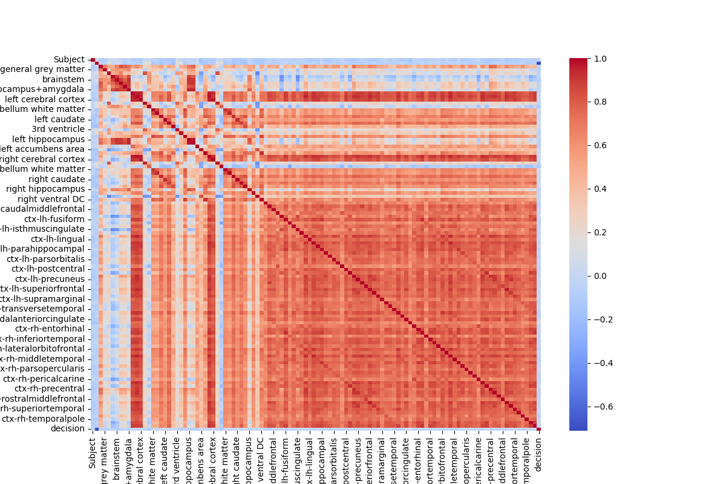
Study Feature Correlation
Hierarchical Clustering Results

Slide 6
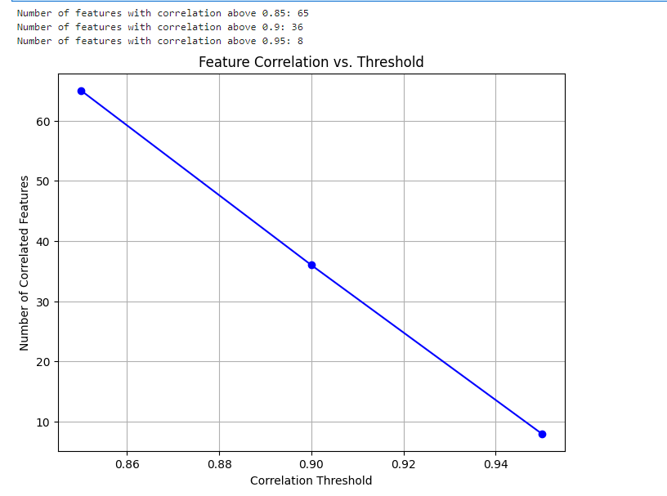
Feature Correlation vs Threshold

Slide 7
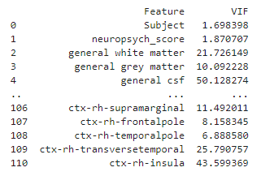
Variance Inflation Factor for Each Feature
The below list of features represents the Variance Inflation Factor for Each Feature.

Slide 8
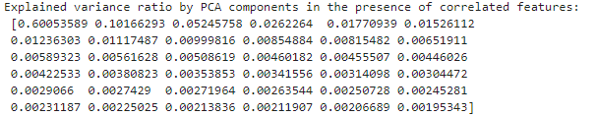
PCA results

Slide 9
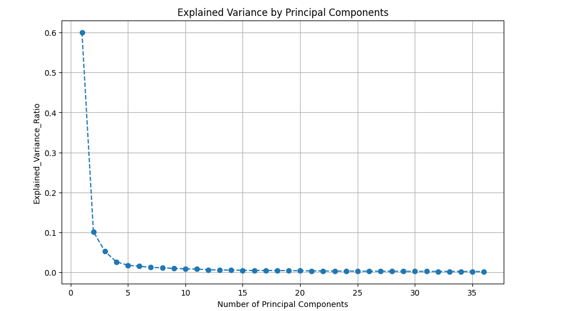
PCA results

Slide 10
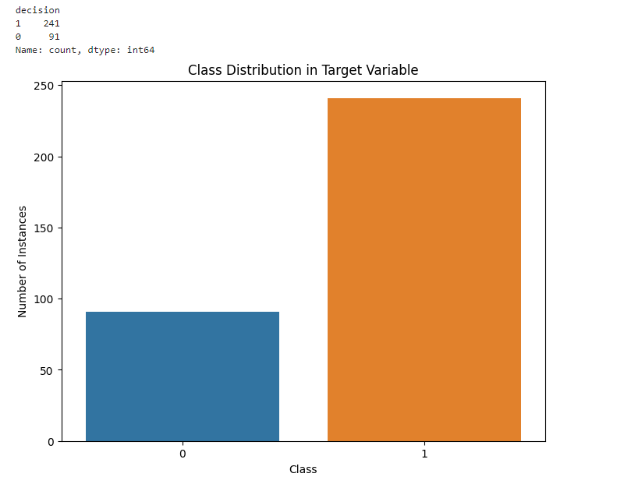
Checking Class Distribution

Slide 11
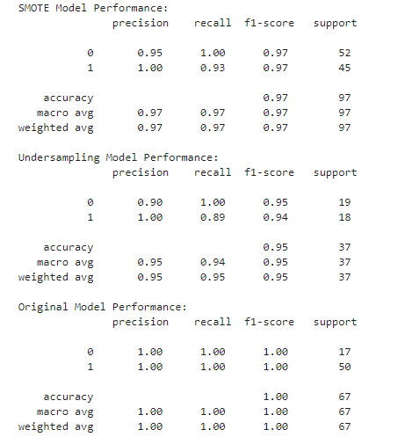

Results of Sampling

Slide 12
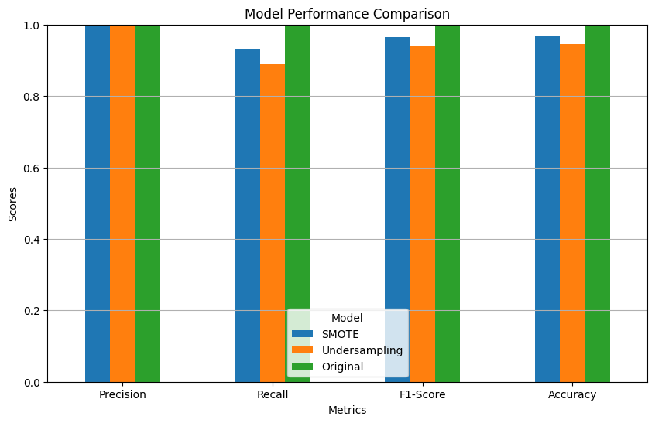
Sampling Results

Slide 13
LASSO Implementation on Sampled Data

Slide 14
Genetic Algorithm For Feature Selection
Genetic Algorithm: A search heuristic that mimics the process of natural selection.
Objective: Optimize feature selection using Genetic Algorithm, combined with Logistic Regression and LDA to enhance model performance.
Key Techniques:
Genetic Algorithm (GA) for feature subset selection.
Logistic Regression (LR) for classification.
Linear Discriminant Analysis (LDA) for dimensionality reduction.

Slide 15
Genetic Algorithm Workflow
Create Individual: A random binary vector representing the inclusion or exclusion of features.
Fitness Evaluation:
Logistic Regression model trained on selected features.
Cross-validation (Stratified K-Fold) used to assess performance (accuracy, precision, recall).
Selection: Elitism to preserve top-performing individuals.
Crossover: Combining the best individuals to generate offspring.
Mutation: Randomly flipping bits to introduce variation.
Convergence: Stop when the fitness score shows minimal change.

Slide 16
LDA Implementation
Linear Discriminant Analysis (LDA):
Applied to the selected features to reduce dimensionality.
Number of components = 1 (default).
LDA transforms the features before passing them to Logistic Regression for classification.
Cross-Validation: Used to ensure model generalizability with precision, recall, and accuracy metrics.

Slide 17
Improvements in the Algorithm
Crossover from Best Individuals: Instead of random selection, parents are chosen from the top-performing individuals to create offspring, ensuring better solutions.
Selection: Best-performing individuals from each generation are carried forward directly.
Fitness Tracking: Convergence check added to stop the algorithm when the change in fitness value becomes minimal across generations.

Slide 18
Performance Metrics
Fitness Metrics :
Accuracy: How well the model predicts.
Precision: Ratio of correctly predicted positive observations.
Recall: Ratio of correctly predicted positive observations to all observations in the actual class.
Generation-wise Fitness Improvement: Tracking the improvement across generations to monitor progress.

Slide 19
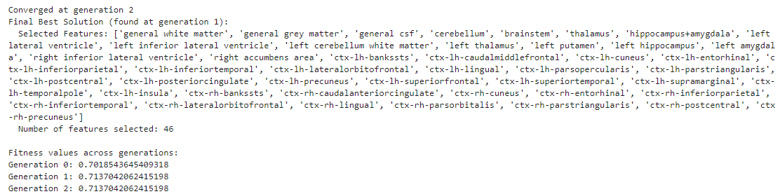
Results Using Original Dataset

Slide 20
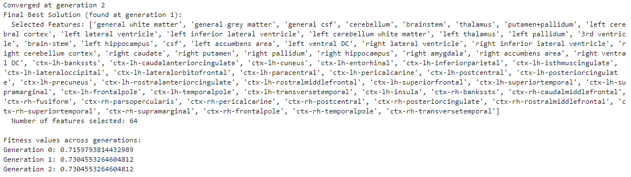
Results Using Oversampled Dataset

Slide 21
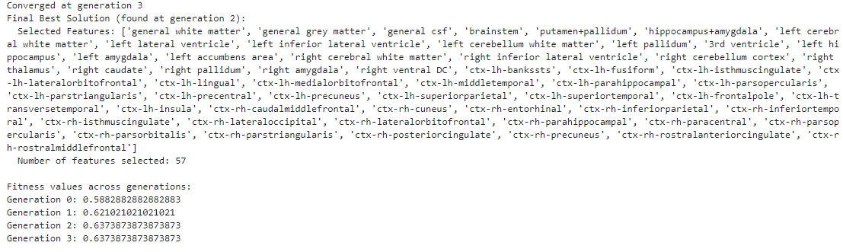
Results Using UnderSampled Dataset

Slide 22
Conclusion
Benefits of Genetic Algorithm: Efficient search of the feature space leading to better model performance.
LDA Integration: Effective dimensionality reduction combined with Logistic Regression.
Future Work: Explore alternative fitness functions or classifiers, such as Support Vector Machines or Random Forests, for enhanced performance.

